Slide 1
APTITUDE
ALGEBRA

Slide 2

APTITUDE
RATIO AND PROPORTION
Q 1.

Slide 3
APTITUDE
Q 3.

Slide 4

APTITUDE
Q 3.

Slide 5

APTITUDE
Q 4. If then

Slide 6

APTITUDE
Q 5. If find the value of

Slide 7


APTITUDE
Algebra VIDEO-1
Q:6. If then find the value of

Slide 8


APTITUDE
Algebra VIDEO-1
Q:7 . If then find the value of 1 .

Slide 9


APTITUDE
Algebra VIDEO-1
Q:8. If , , then the value of is

Slide 10
APTITUDE
ALGEBRA VIDEO-1
Q: 9. Find the maximum value of the expression (p²+7p+13)⁻¹.
a) 5/7 b) 4/3 c) 20 d) 3/7

Slide 11
APTITUDE
ALGEBRA VIDEO-1
Q:10. Find the values of x where the quadratic expression
2x² - 3x + 5 (x ϵ R) reaches a minimum value. Also find the minimum value?

Slide 12
APTITUDE
ALGEBRA VIDEO-1
Q:11. Find the Maximum/Minimum Value f(x) = x² – 4x + 2

Slide 13
APTITUDE
ALGEBRA VIDEO-1
Q:12. The minimum value of (x-2)(x-9) is:
a) -11/4 b) 49/4 c) 0 d) - 49/4

Slide 14

APTITUDE
Algebra VIDEO-1
Q:13. If than find the value of .

Slide 15

APTITUDE
Algebra VIDEO-1
Q:14. If than find the value of

Slide 16
APTITUDE
Algebra VIDEO-1
Q:15.If then find the value of .

Slide 17

APTITUDE
Algebra VIDEO-1
Q:16.If then what is the value of
a) 0
b) 1
c) 2
d)

Slide 18
APTITUDE
Algebra VIDEO-1
Q:17. If than find the value of
a)
b)
c)
d) None of these

Slide 19

APTITUDE
Algebra VIDEO-1
Q:18.
a).
b).
c).
d).

Slide 20

APTITUDE
Algebra VIDEO-1
Q:19If then the value of is
a)
b)
c)
d) 1

Slide 21
APTITUDE
Algebra VIDEO-1
Q:20.If then find the value of

Slide 22
APTITUDE
Algebra VIDEO-1
Q:21.If than
a)
b) 3
c)
d) 3

Slide 23
APTITUDE
Algebra VIDEO-1
Q:22. If then the value of
is equal to :
a)
b)
c)
d)

Slide 24
APTITUDE
Algebra VIDEO-1
Q:23.

Slide 25

APTITUDE
Algebra VIDEO-1
Q:24 .

Slide 26

APTITUDE
Algebra VIDEO-1
Q:25.

Slide 27

APTITUDE
Algebra VIDEO-1
Q:26.

Slide 28
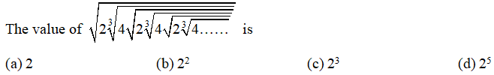
APTITUDE
Algebra VIDEO-1
Q:27.

Slide 29


APTITUDE
Algebra VIDEO-1
Q:28.If then
(a) 1 (b) 2 (c) 3 (d) 4

Slide 30

APTITUDE
Algebra VIDEO-1
Q:29. If than find the value of x ?
(a) 1/5 (b) 12/5 c) 3/5 (d) 4/5

Slide 31


APTITUDE
Algebra VIDEO-1
Q:30. if and than
find the value of

Slide 32
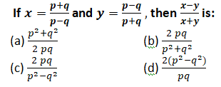
APTITUDE
Algebra VIDEO-1
Q:31.

Slide 33
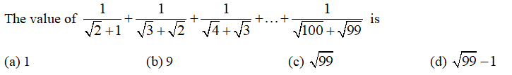
APTITUDE
Algebra VIDEO-1
Q:32.

Slide 34

APTITUDE
Algebra VIDEO-1
Q:33

Slide 35

APTITUDE
Algebra VIDEO-1
Q:34.
= ?

Slide 36

APTITUDE
Algebra VIDEO-1
Q:35.

Slide 37
APTITUDE
Algebra VIDEO-1
Q:36. A complete factor form of
a.
b.
c.
d. None of these.

Slide 38
APTITUDE
Algebra VIDEO-1
Q:37. if x – y= 2, xy= 24, than what will be the value of ?

Slide 39
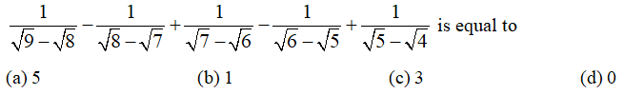
APTITUDE
Algebra VIDEO-1
Q:38.

Slide 40

APTITUDE
Algebra VIDEO-1
Q:39.

Slide 41

APTITUDE
Algebra VIDEO-1
Q:40.If and then the value of is.

Slide 42
APTITUDE
Q.41-

Slide 43
APTITUDE
Q.42-

Slide 44
APTITUDE
Q.43-

Slide 45
APTITUDE
Q.44-

Slide 46
APTITUDE
Q.45-

Slide 47

APTITUDE
QUADRATIC EQUATION
In the following questions two equations numbered I and II are given. You have to solve both the equations
Q.46-

Slide 48

APTITUDE
QUADRATIC EQUATION
Directions: In each of these questions, two equations (I) and (II) are given. You have to solve both the equations and give answer.
Q.47-

Slide 49

APTITUDE
QUADRATIC EQUATION
Directions: In each of these questions, two equations (I) and (II) are given. You have to solve both the equations and give answer.
Q.48-

Slide 50
APTITUDE
QUADRATIC EQUATION
Directions: In each of these questions, two equations (I) and (II) are given. You have to solve both the equations and give answer.
Q.49- I. 10x²-11x +3 = 0 II. y²+30y +224 = 0

Slide 51
APTITUDE
QUADRATIC EQUATION
In the following questions two equations numbered I and II are given. You have to solve both the equations
Q.50- I. 10x²-11x -35 = 0 II. y²-19y -92 = 0

Slide 52
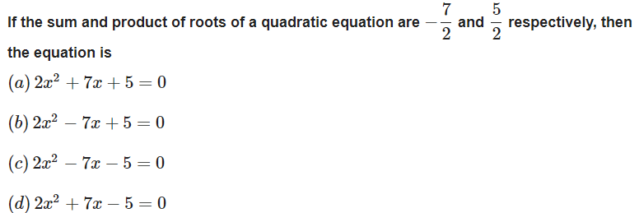
APTITUDE
Q.51-

Slide 53
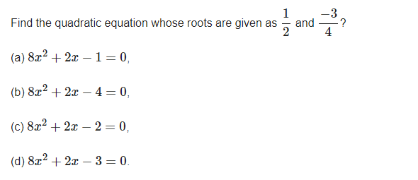
APTITUDE
Q.52-

Slide 54
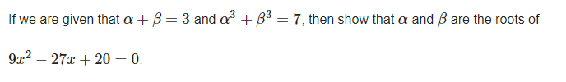
APTITUDE
Q.53-

Slide 55
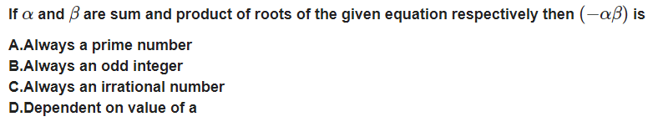
APTITUDE
Q.54-

Slide 56
APTITUDE
Q.55-

Slide 57
APTITUDE
Q.56-
If k is real, discuss the nature of the roots of the polynomial equation 2x² + kx + k = 0, in terms of k .

Slide 58
APTITUDE
Q.57-
Find a polynomial equation of minimum degree with rational coefficients, having 2 + √3 i as a root.

Slide 59
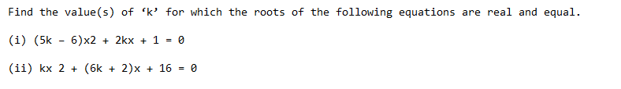
Q.58-

Slide 60
APTITUDE
Q.59-

Slide 61
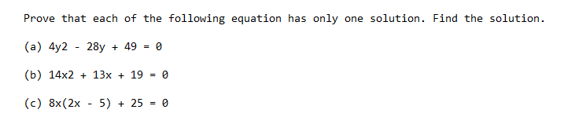
APTITUDE
Q.60-

Slide 62
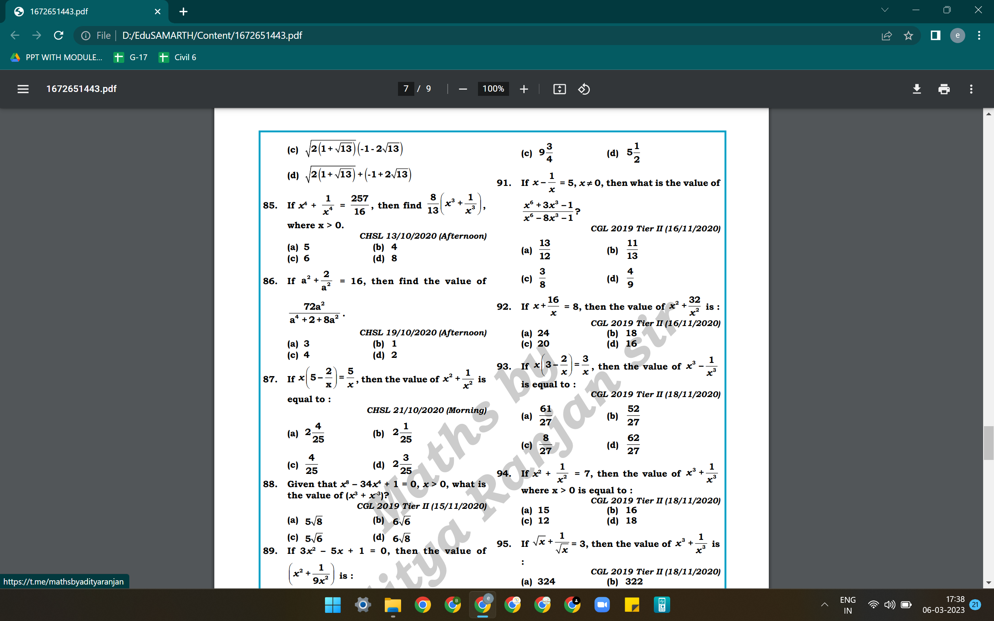
APTITUDE
Q.61-

Slide 63
APTITUDE
Q.62-

Slide 64
APTITUDE
Q.63-

Slide 65
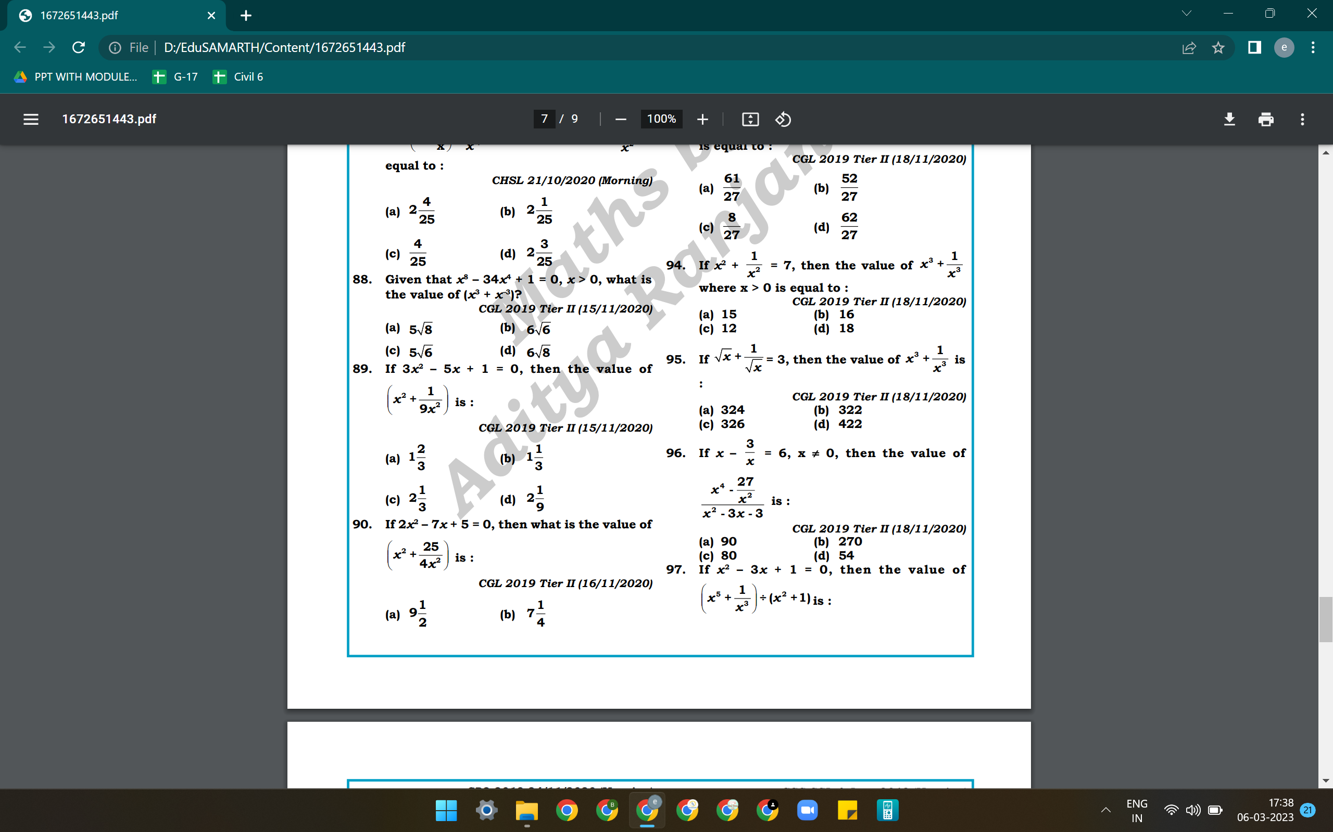
APTITUDE
Q.64-

Slide 66
APTITUDE
Q.65-

Slide 67
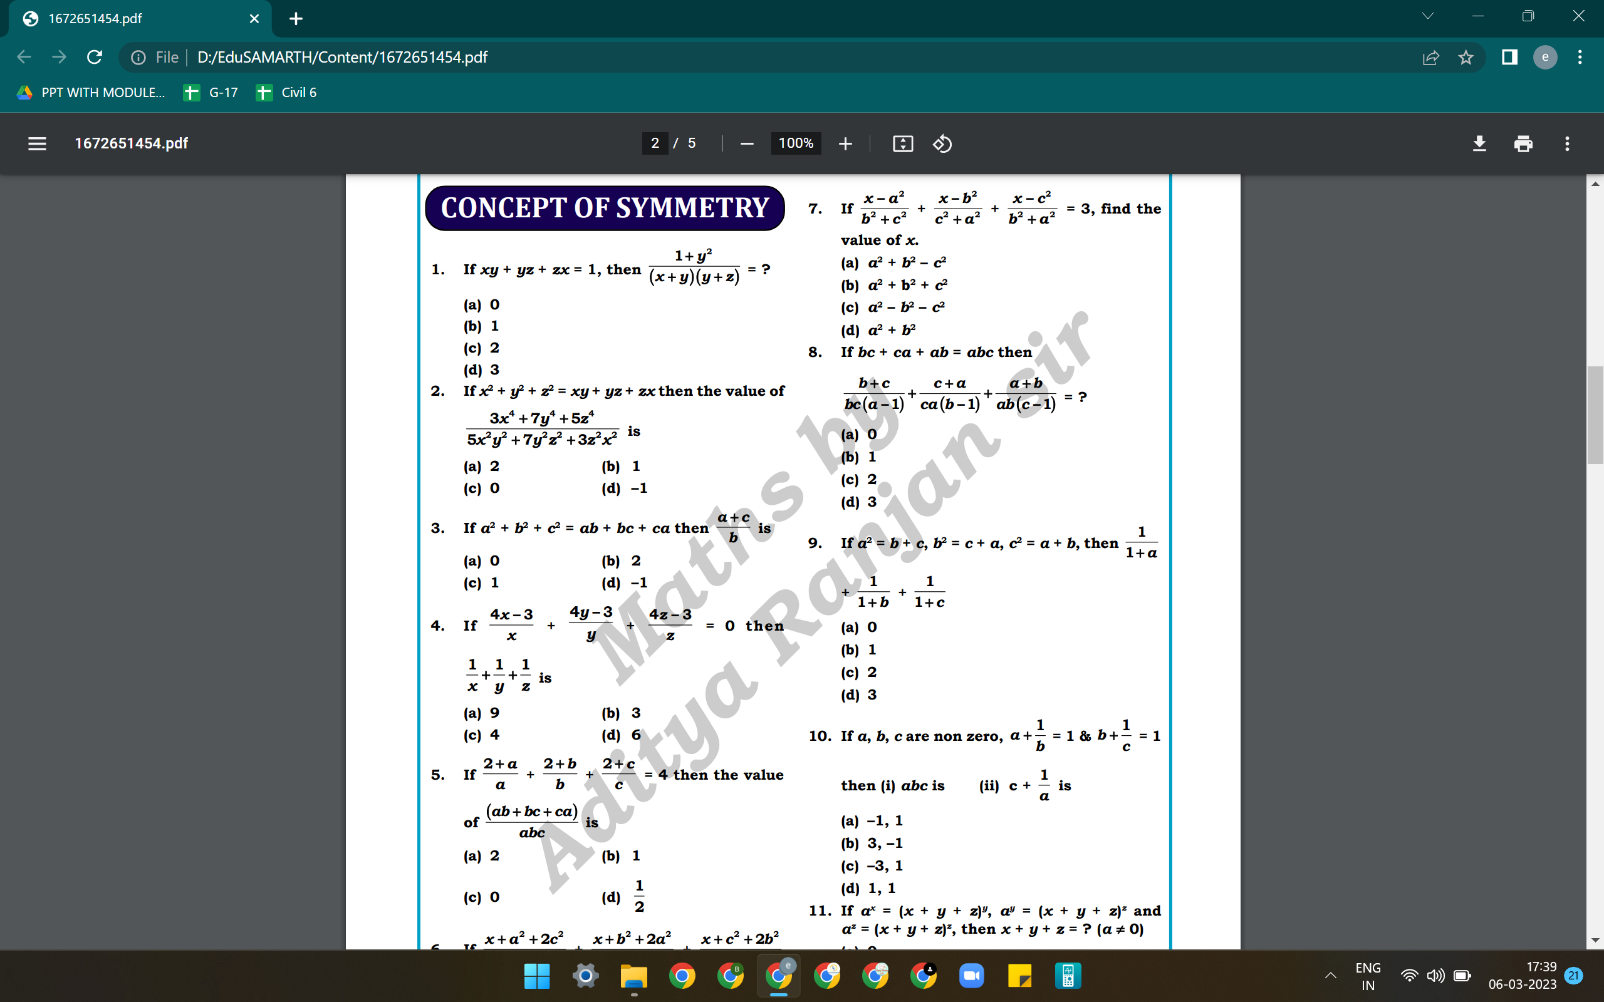
APTITUDE
Q.66-

Slide 68
APTITUDE
Q.67-

Slide 69
APTITUDE
Q.68-

Slide 70
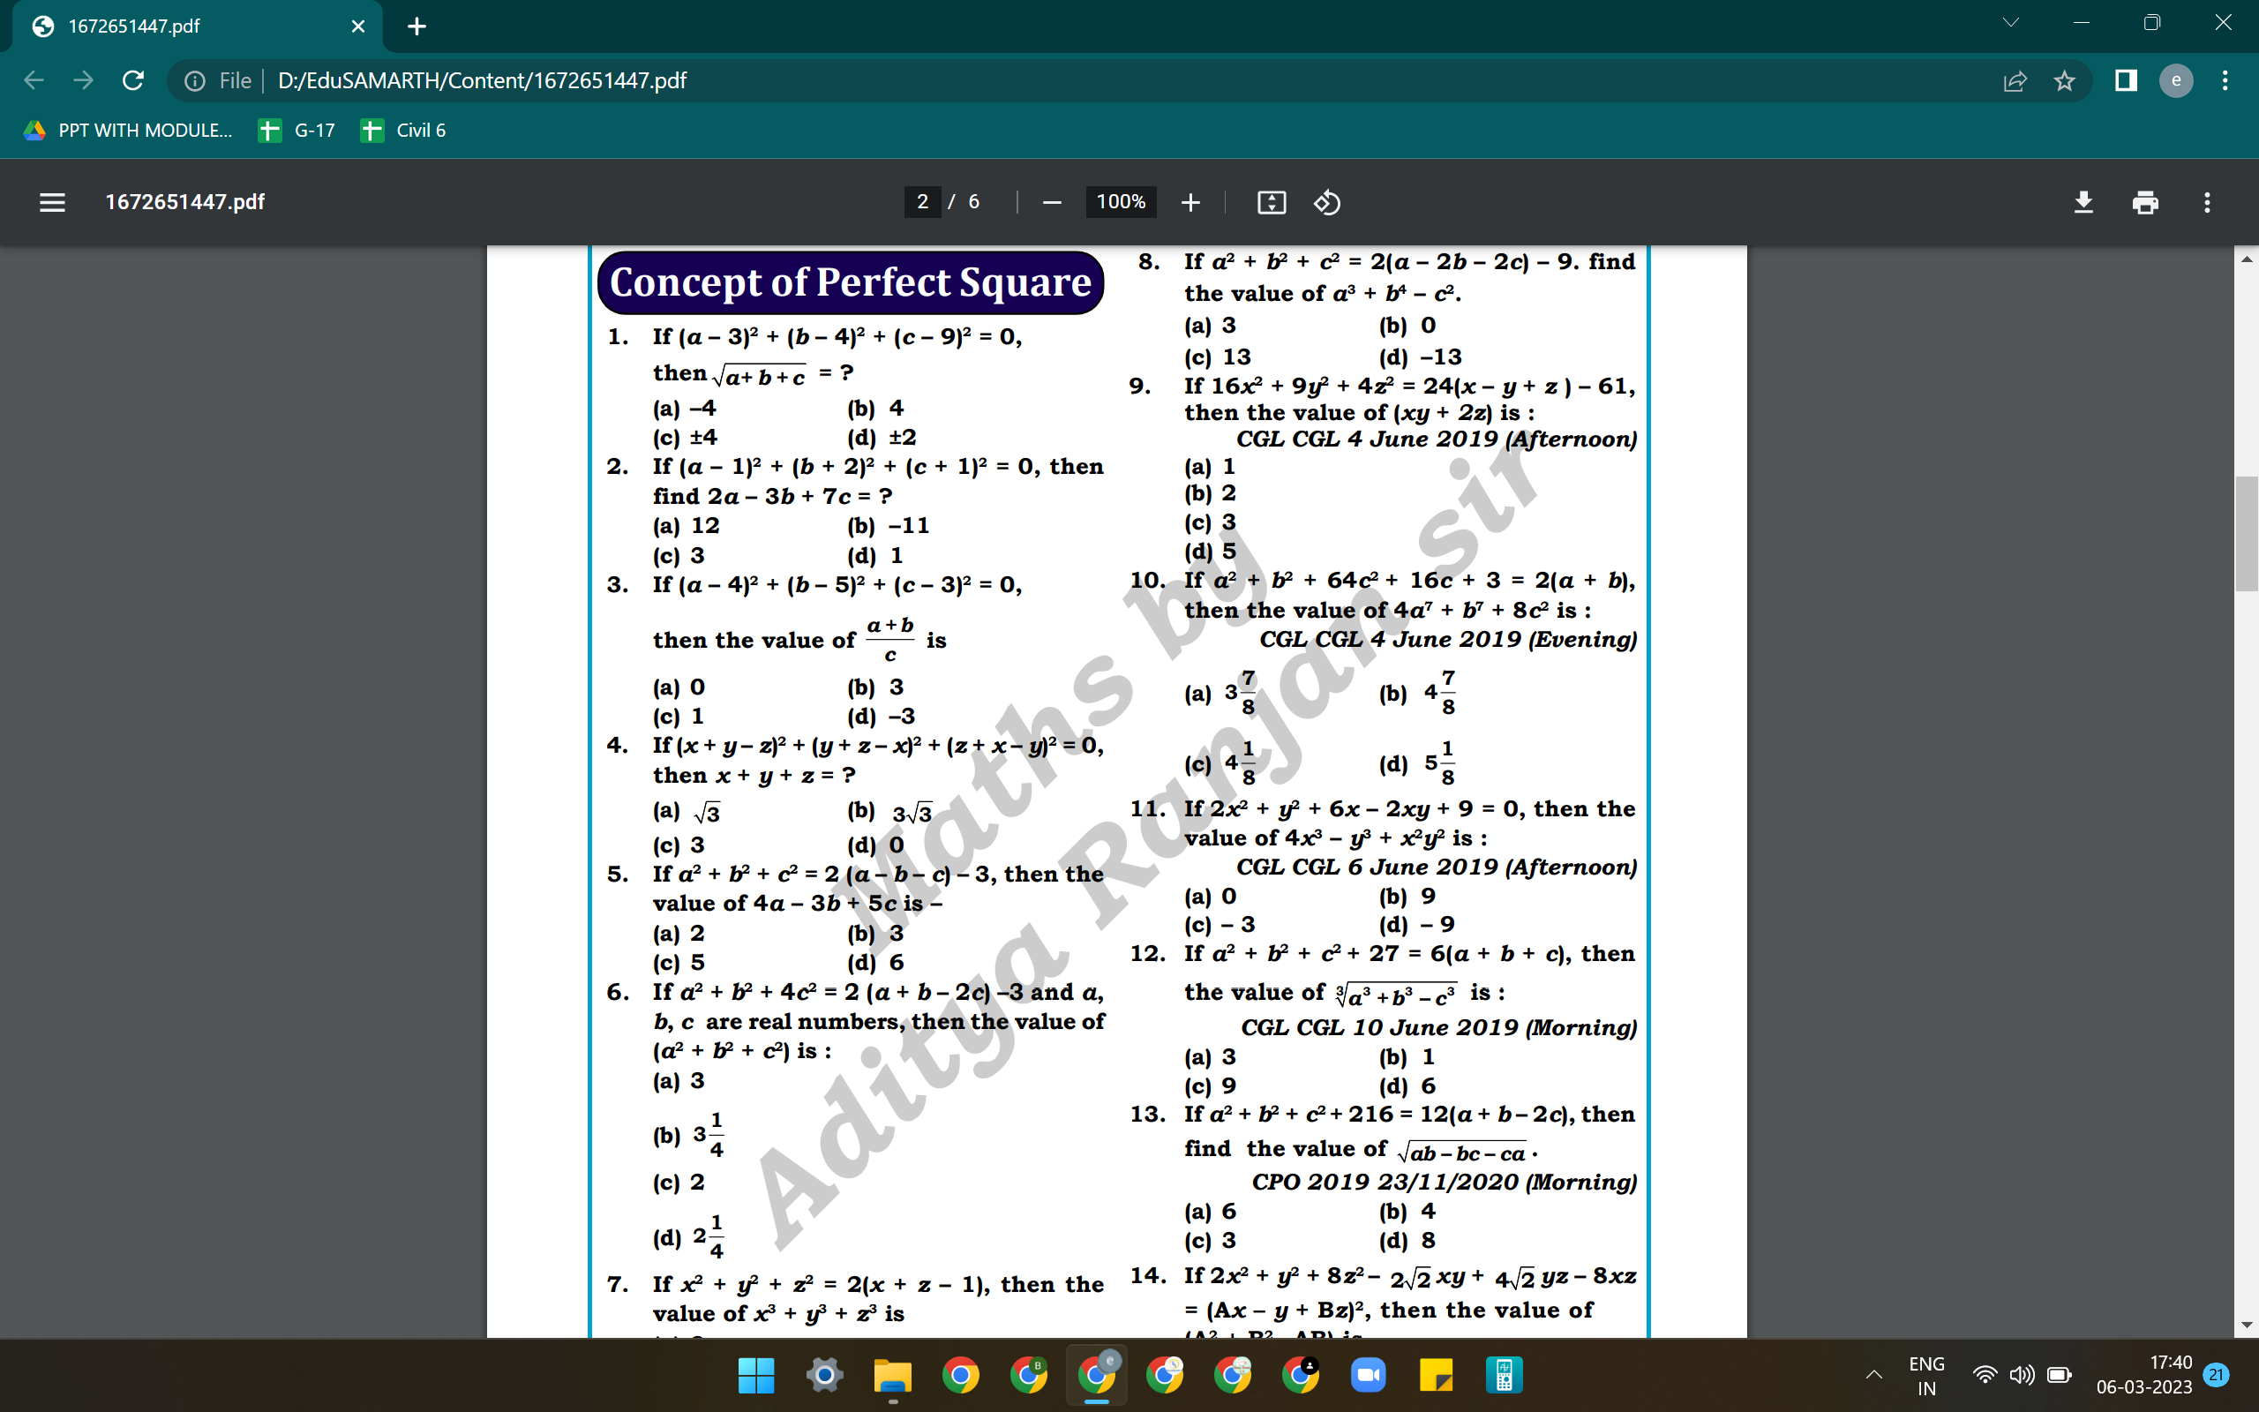
APTITUDE
Q.69-

Slide 71
APTITUDE
Q.70-

Slide 72
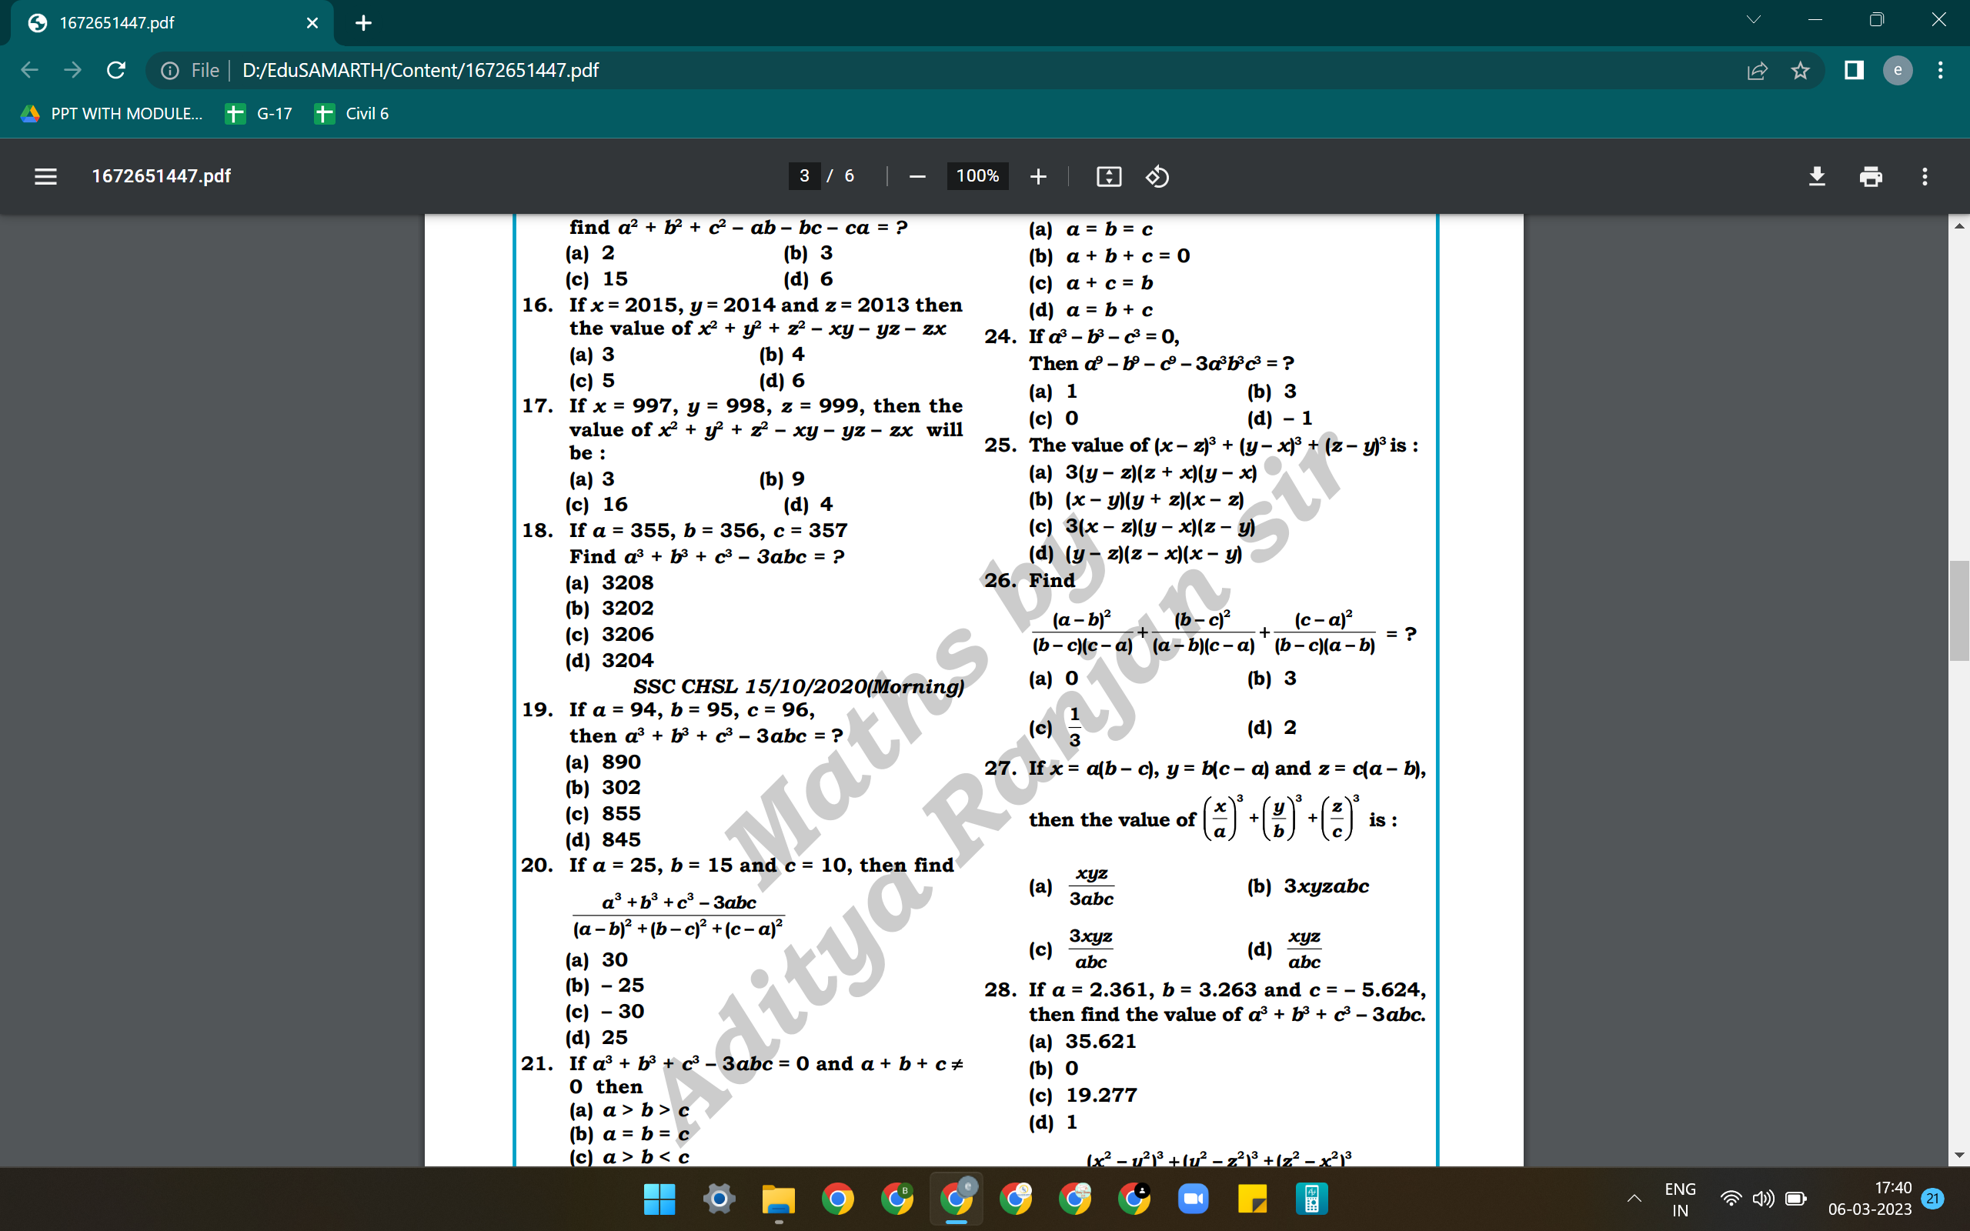
APTITUDE
Q.71-

Slide 73
APTITUDE
Q.72-

Slide 74
APTITUDE
Q.73-

